Slide 1

JavaScript Basic
Vojtěch Šebek

Slide 2
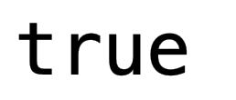
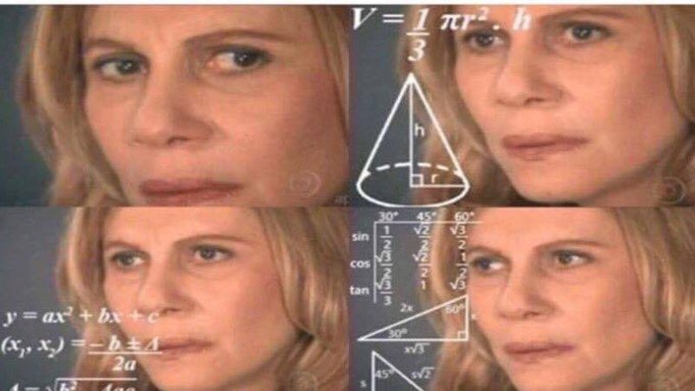
Motivation
https://i0.kym-cdn.com/entries/icons/mobile/000/021/464/14608107_1180665285312703_1558693314_n.jpg
Copyright © 2016 Unicorn Top Gun Academy
Notes:
motivation is always important
in this case, it is tainted that JS is different in many ways and has it unique behaviour

Slide 3
Agenda
JavaScript
types
loops
collections
Copyright © 2016 Unicorn Top Gun Academy
Notes:
angenda seems to be short but it is important to understand the basics of the language for upcoming mission

Slide 4
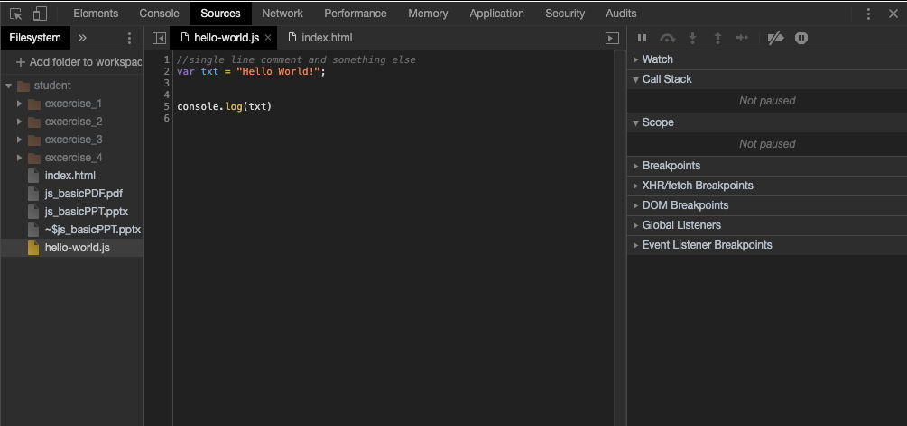
Preparing development environment
Chrome
IDE - IntelliJ (only full versions) or VSCode
Notes:
for those, who have never used any IDE, it is not required to use any for this mission
Chrome has Developer tools which are good enough

Slide 5
VSCode plugins:
recommended for this mission:
terminal
JavaScript (ES6) code snippets
Path Intellisence
recommended for upcoming missions:
npm
npm Intellisence
Eslint
Prettier
jest
Node.js Modules Intellisence
node-readme
Node JSON Autocomplete
gitignore
Jest Snippets
Jest Runner
Jest Test Explorer + Test explorer UI
optional, but it might make your life easier
Material Icon
JS Refactor
IntelliJ IDEA Keybinding
GitLens
Atom one dark Theme
Notes:
Go through recommended plugins for this mission at least
everyone who will use VSCode during this mission or for any following mission should install at least recommended plugins
plugins in the option section are my favourite plugins, makes the IDE look better, helps with refactoring and also allows to use same shortcuts across multiple IDEs
GitLens is IDE alternative to software like Sourcetree, it is really easy to use, for example to compare multiple versions of project, see who did what etc

Slide 6
JS Intro
JavaScript is the programming language
for browser and server
JavaScript nad Java are completely different languages
Invented in 1995
ECMAScript is the official name of the language
Notes:
short intro about the history of the JS
do not waste too much time on this, history is not interesting for most of the developers

Slide 7
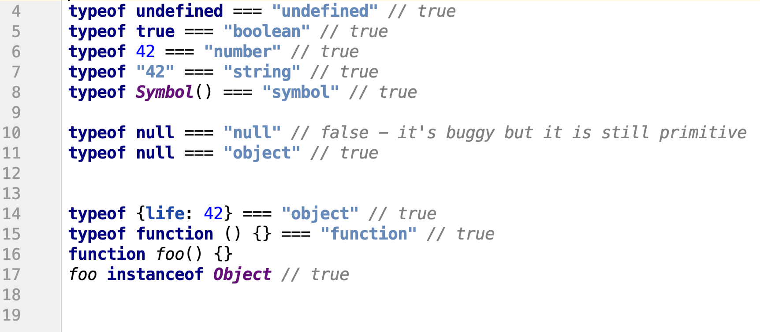
Types
6 primitives
string, number, boolean, null, undefined, symbol
Objects
operators: typeof, instanceof
typeof to převede na typ, o který se jedná, takže porovnáváme s daným stringem
Notes:
it is important to know that everything what is not primitive is object, except operators etc of cource
for example classes are syntax sugar for functions which are also objects <- good example but more about it in the JS Advance
do not forget, that typeof null returns object, it is one of the oldest bugs in the JS and probably won’t be fixed, because it would make much more problems in the existing code

Slide 8
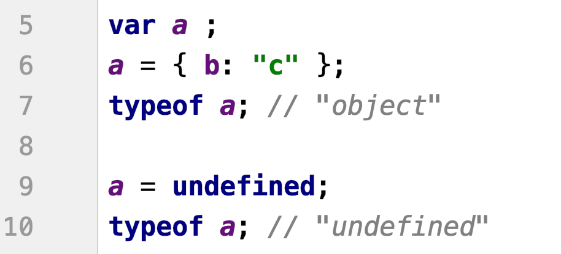
Types
typeof is not asking for type of a variable but rather for the value currently in a
only values have types in JS
by setting a to undefined, behaviour is as if a has no value set yet
Notes:
JS is dynamically typed language so the type of the value is not saved in the variable but in the value itself
you can mention the exact opposite in Java

Slide 9
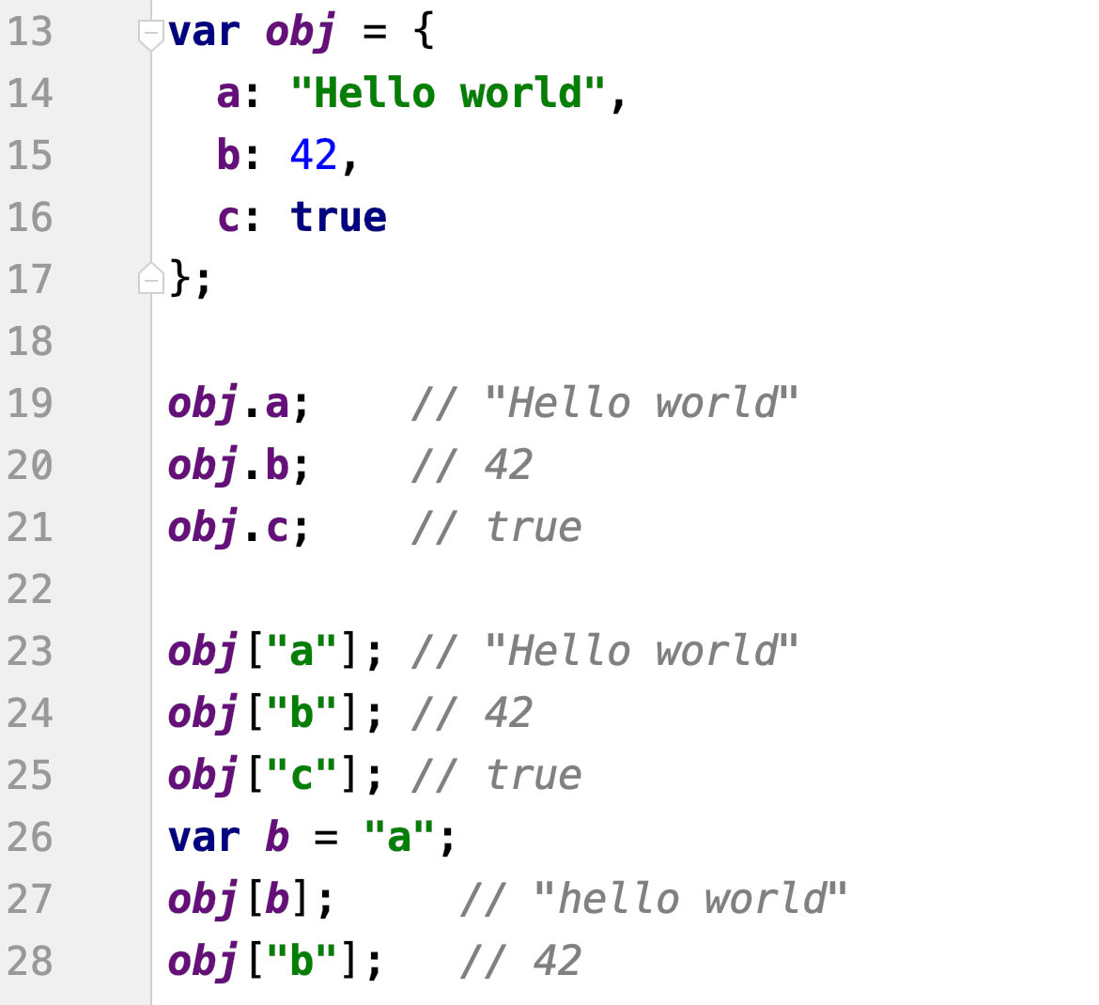
Objects
you can set properties, each hold their own value of any type
dot notation - easier to read
bracket notation - variables can be used, special characters
k proměnným v objektu se
přistupuje pomocí stringu, proto se do proměnný hodí “a” na 26 a pak se přistupuje k objektu na hodnotu proměnný a - to samý jako obj.a
Notes:
objects are used everywhere and it is impossible to write useful a code without them, so we need to know how to use them
dot notation is used most of the time, brackets should be used if you want to use a variable as a key, otherwise prefer dot notation

Slide 10
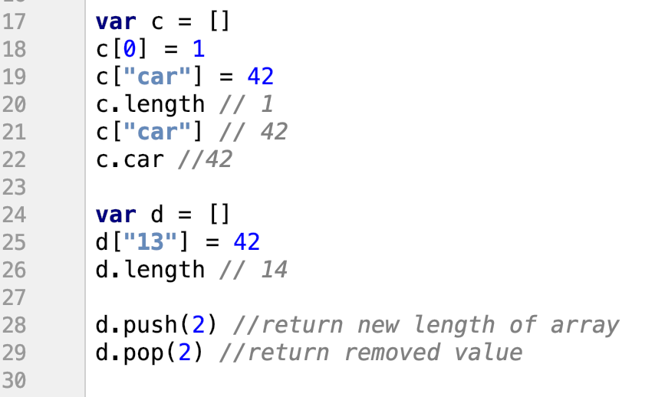
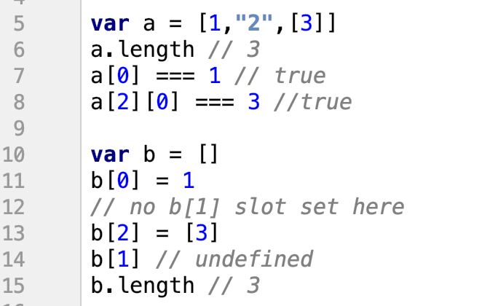
Arrays
arrays are still objects
numerically indexed
length based on highest index
8 - chci 3 položku z pole, což je pole a z něho chci 1 element
Javascript umožňuje dávat děravý pole, tzn vynechá klidně nějaký element.
Na prázdných pozicích je undefined
Délka je pak podle poslední pozice (tzn. když dám jediný elemnt na 11pozici, tak je length 11
můžeme kombinovat pole a objekt, takže když dá člověk do pole[“car”], tak se k tomu přistupuje jako objekt a pole zároveň
pozor, když dám číslo do uvozovek u pole, tak se to převede na index
push - přidá na poslední pozici pole další proměnnou
pop - vrátí a vymaže poslední pozici z pole
Notes:
arrays are still object, so we can do same things with them, but by default the are trying to convert a key, passed to the brackets, to a number
on the other hand, simple objects are trying to convert key to the string
length of the array are based on the highest index, so it is possible to have indexes without value -> undefined
prefer to use methods like push and pop instead of passing value manually to specific index, if it is possible

Slide 11
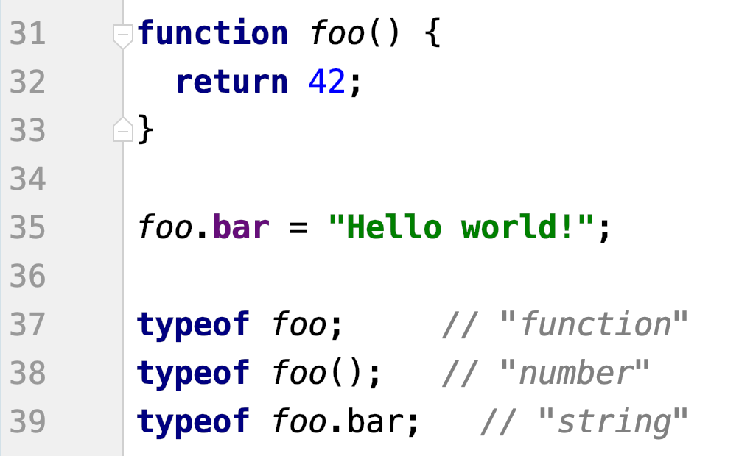
Functions
function is still object subtype
keyword return
na proměnnou může být navázaná funkce, objekt, proměnná - bleh, nedělat!
Notes:
this slide is just an intro how functions are defined and that they are still objects
keyword “return” to return a value as a response from a function

Slide 12
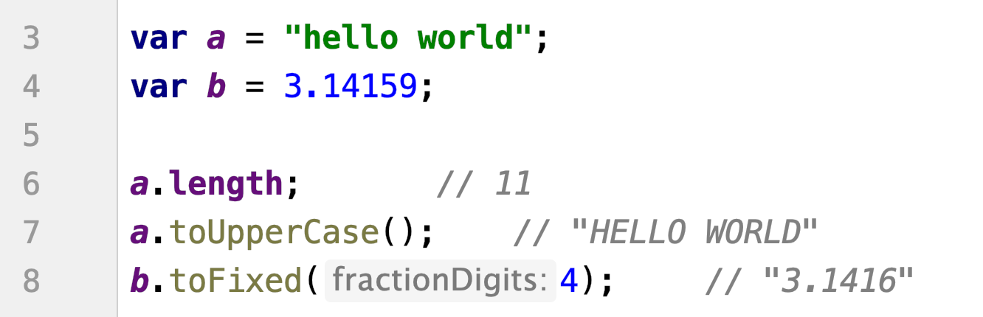
Build-In Type Methods
object wrappers of primitives - called natives
string - String
boxing process
nad textem a čísly můžeme volat nějaký předdefinovaný akce
boxing - udělá z toho objekt (dělá si JS sám)
Notes:
a brief mention that there are also object version for most of the primitives which are used in case, that you want to get for example length of some string
it convert the primitive to object, the method is called and then the object is destroyed
more about it in the next mission

Slide 13
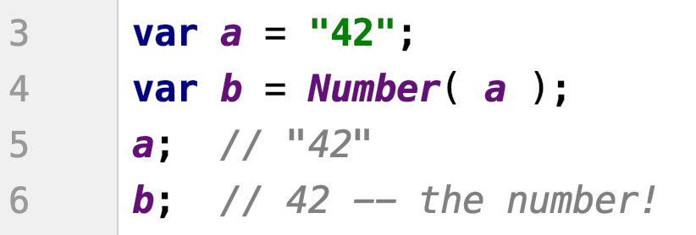
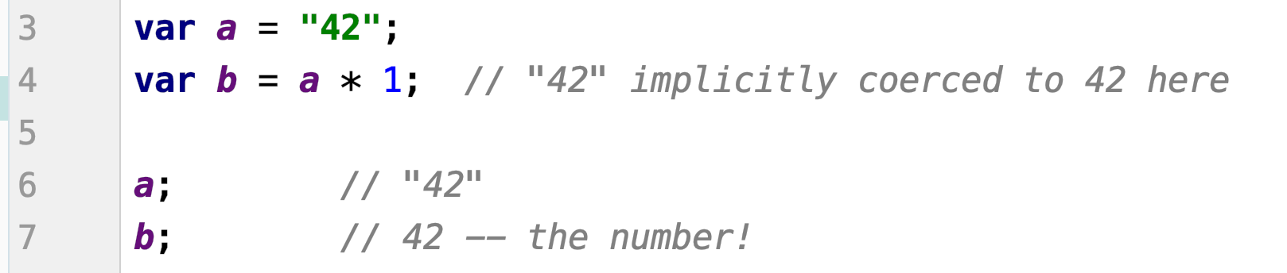
Coercion
explicit
you can see obviously from the code
implicit
can happen as n non-obvious side effect of some operation
umí převádět automaticky string na text
4 - udělá z toho číslo (explicitně
Implicitní převod - sám si převede string na číslo
Notes:
how data types are converted
there are two ways, explicitly and implicitly
both ways works, but to make the code cleaner, it is recommended explicit which is more obvious when you are reading code

Slide 14
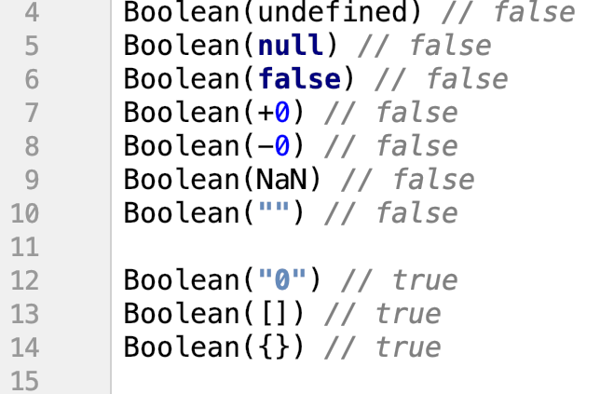
Truthy and falsy values
when a non-boolean value is coerced to a boolen, does it become true of false?
falsy values:
"" empty string
0, -0, NaN
null, undefined
false
anything else is truthy
JS převádí automaticky hodnoty na Boolean tak, jak by si asi člověk myslel, že to má vrátit false/true - no tvl.
těm hodnotám, co vrátí false se říká falsy, viz ukázka
tady co dá if když tam hodím něco
https://dorey.github.io/JavaScript-Equality-Table/
Notes:
it is good to know which values are falsy, anything else is truthy
it is useful mainly in conditionals, when you can use a shorter notation as we will see soon

Slide 15
Equality
four equality operators:
==
goes through series of steps to coerce one or both values to a same type
42 == "42" //true
===
coercion is not allowed
42 === "42" //false
!=
!==
pokud tam dáme 3 rovnítka, tak JS řekneme porovnávej to tak jak to je a nijak to nekonvertuj.
=> Prostě vždycky používej 3 rovnítka a bude to fungovat normálně
Notes:
main different between == and === is that == tries to convert those values to the same time if they are not already
in modern JS, there are only a few exception when you might want to use == instead of ===, for example to check that values is not null and also not an undefined (a != null)
if you are not 100% sure that you know the benefit of using coercion, use ===

Slide 16
Relational operators
<, >, <=, >=
typically used with ordinally comparable values like number
3 < 4
JS string values can also be compared
"bar" < "foo"
comparison is made alphabetically
if both values are not type number or string, they are both coerced to be number
string is corced to the NaN (invalid number value)
porovná pozici v abecedě
pokud neni string ani číslo, tak to převede na číslo
Notes:
Relation operators are mostly used with numbers but they can be also used for strings
for objects, it is easier to write a comparator function

Slide 17
Variables
variable name must be valid identifier
must start with a-z, A-Z, $ or _
then it can also contain 0-9
same rules for properties
cant use reserved words
Notes:
underscore is used for private methods/functions
variable names for constants are often in capital letters only with underscore to separate words

Slide 18
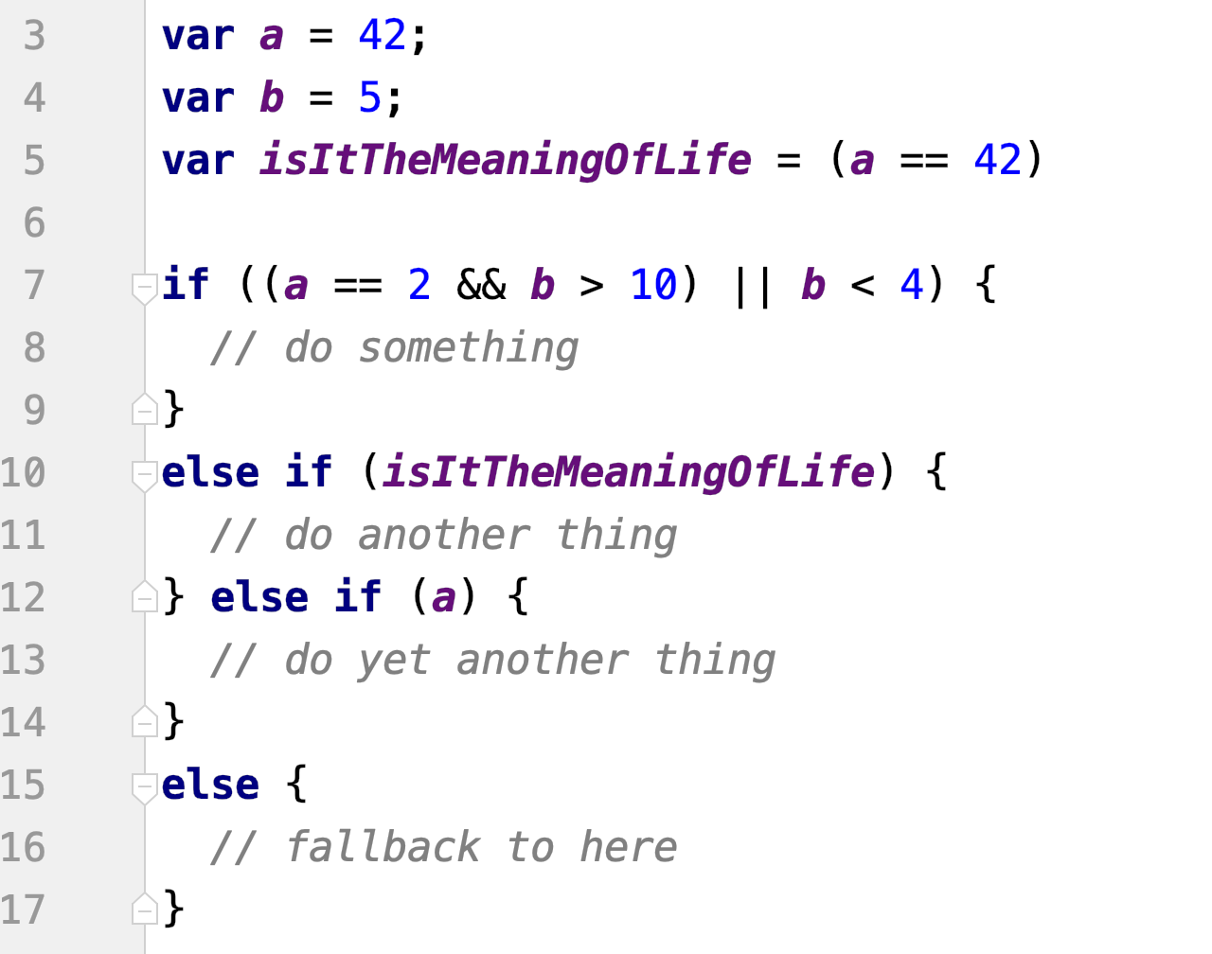
Conditionals
difficult conditions should be separated
truthy/falsy values
nasetuje na true
Notes:
- && represents logical AND, || represents logical OR
use brackets to combine conditions
you can pass the boolean in the variable to to condition
or you can also rely on truthy/falsy values, on the line 12, there is a variable with value 5, which is evaluated as true because number 42 is truthy

Slide 19
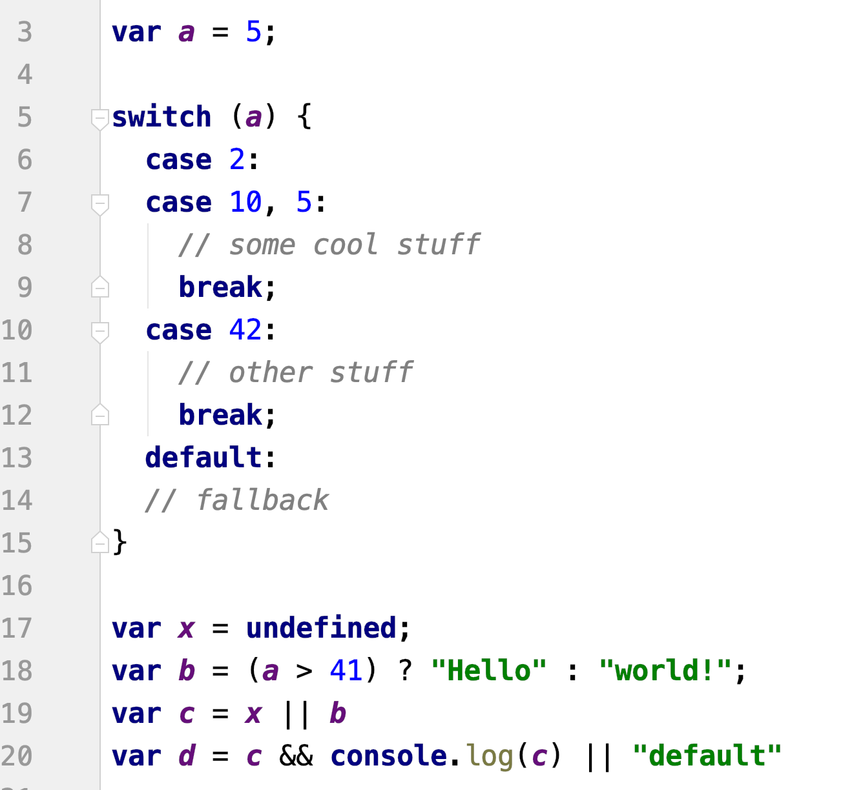
Conditionals
break prevents further processing
if a is either 2, 10 or 5, it will execute "some cool stuff"
pozor, když nedáš break, tak se provedou obě varianty
falsy values - hod do proměnný c hodnotu x, pokud není prázdný, jinak b. Pokud jsou prázdný obě, tak tam spadne první.
hoď do d c a zaloguj, pokud není prázdný, jinak tam napiš default
Notes:
switch is alternative to large if/else
ternal operators for simple, single line conditions

Slide 20
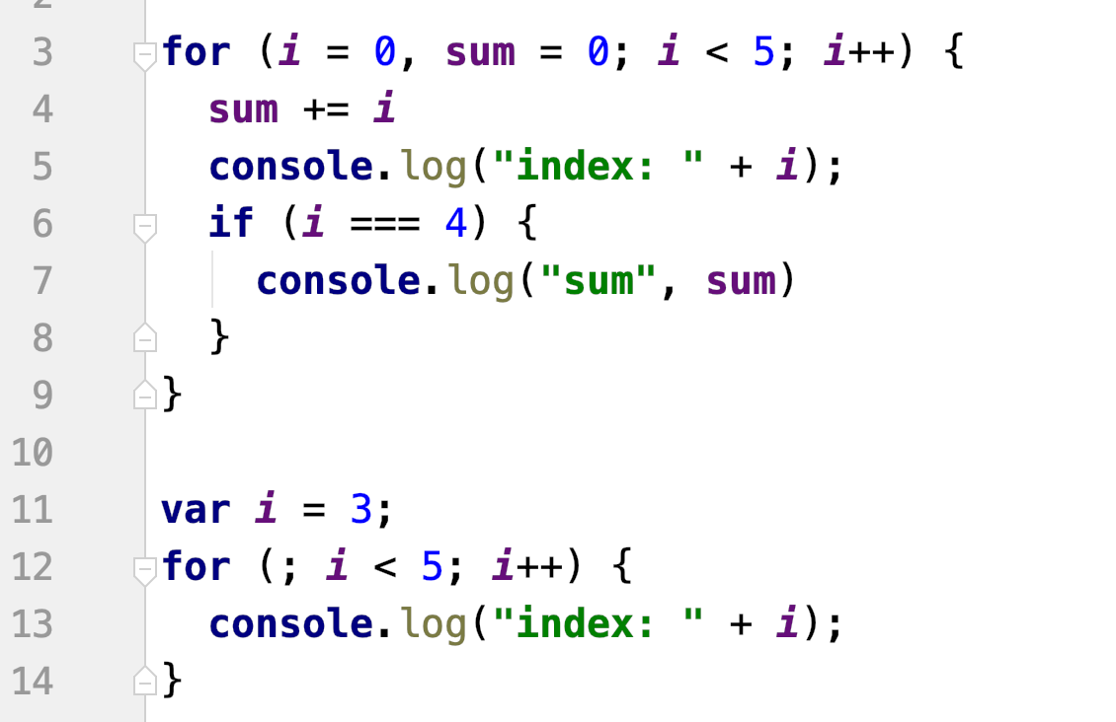
Loops - For Loop
run same code over and over again with different value
jde tam definovat víc věcí
jde definovat i před cyklem
Notes:
loops are used to execute some code multiple times
one of the simpliest loop is a for loop
you define the variable(I = 0), condition for how long it should iterate(I < 5) and operation which should be done at the end of the iteration (i++)

Slide 21
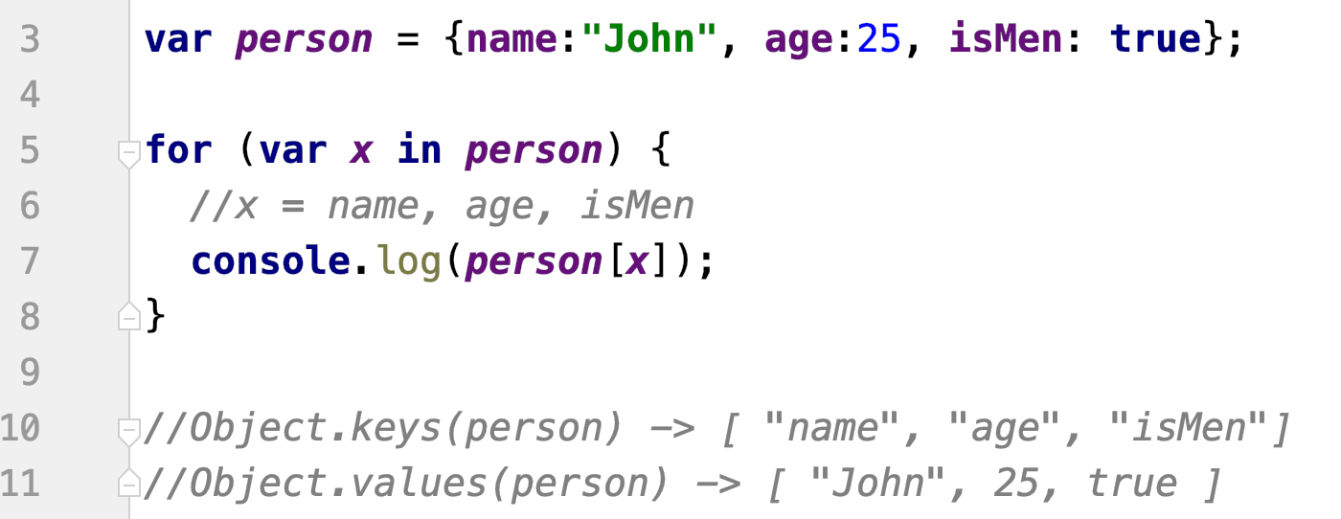
Loops - For/In Loop
loops through the properties of an object
return indexes in case of array
do x mi hod postupně hodnoty z objektu, pokud by tam byly jenom x, tak to tam vypíše jednotlivý klíče
do konzole jde dát víc věcí, takže jde console.log(x, person[x])
vypíše vždycky klíče a hodnoty objekty
nemusíme si to pamatovat, stačí na objektu zavolat values, nebo keys a do parametru mu dát samotný objekt, který nás zajímá -> on vrátí samotné hodnoty
Notes:
loop for simple object iteration
in the example above, in variable X is name of a key from the object in every iteration
to get the value from the object under that key, use person[x]

Slide 22
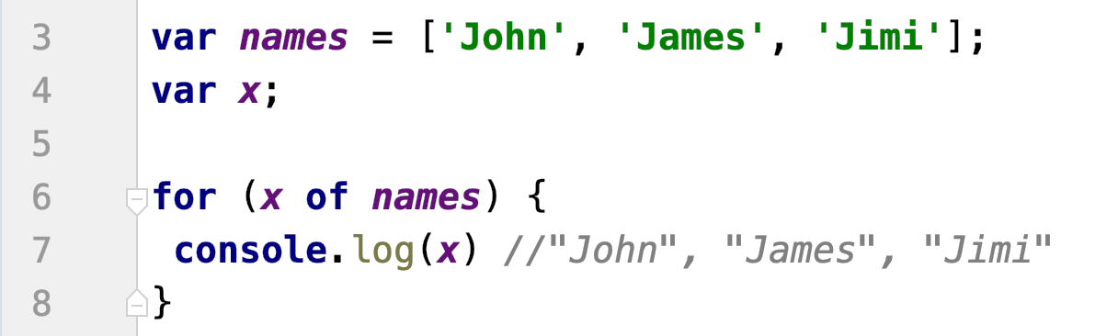
Loops - For/Of Loop
loops through the values of an iterable objects
arrays, strings, maps, etc
object is not iterable by default
Notes:
loop for simple array iteration
it works similar to previous loop, but in the variable X is the value itself

Slide 23
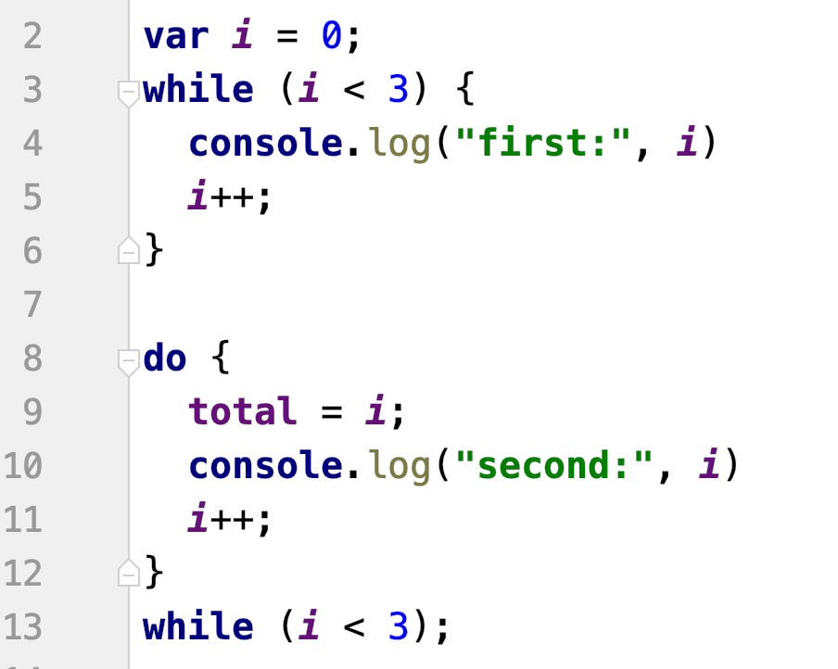
Loops - While and Do/While Loop
execute a block of code s long as a condition is true
rozdíl nejdřív vyhodnotit a spustit, nebo naopak
Notes:
alternative to for loop
different between them is that while loop check the condition at the beginning of the iteration and the do while loop do that at the end, so there will be always at least one iteration

Slide 24
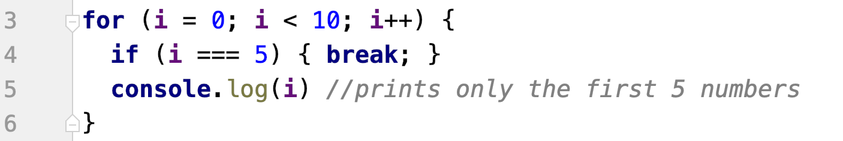
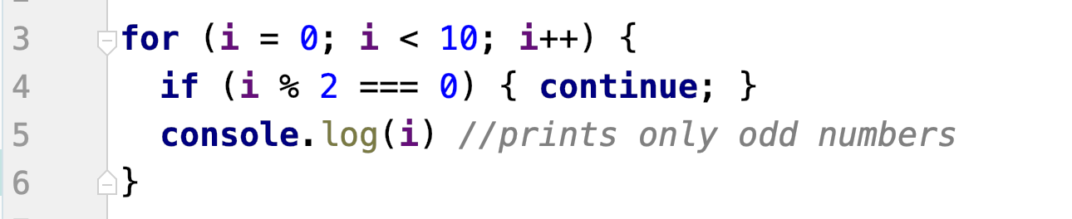
Loops - Break and Continue
break is used to end the loop
continue is used to skip one iteration
Notes:
break allows to end the loop – for example if you already found the value
continue allows to skip the iteration – let’s say, that you want to do some operation only for values which meet some condition

Slide 25
Exercise 1
1.1: sum of even elements of array
1.2: find median in sorted array
1.3: find modus
1.4: unique elements (without set)
1.5: object to string "(key -> value; key -> value)"
without nesting, only top level
Notes:
explain what is median (middle value) and modus (most common value) -> most of the people do not know that

Slide 26
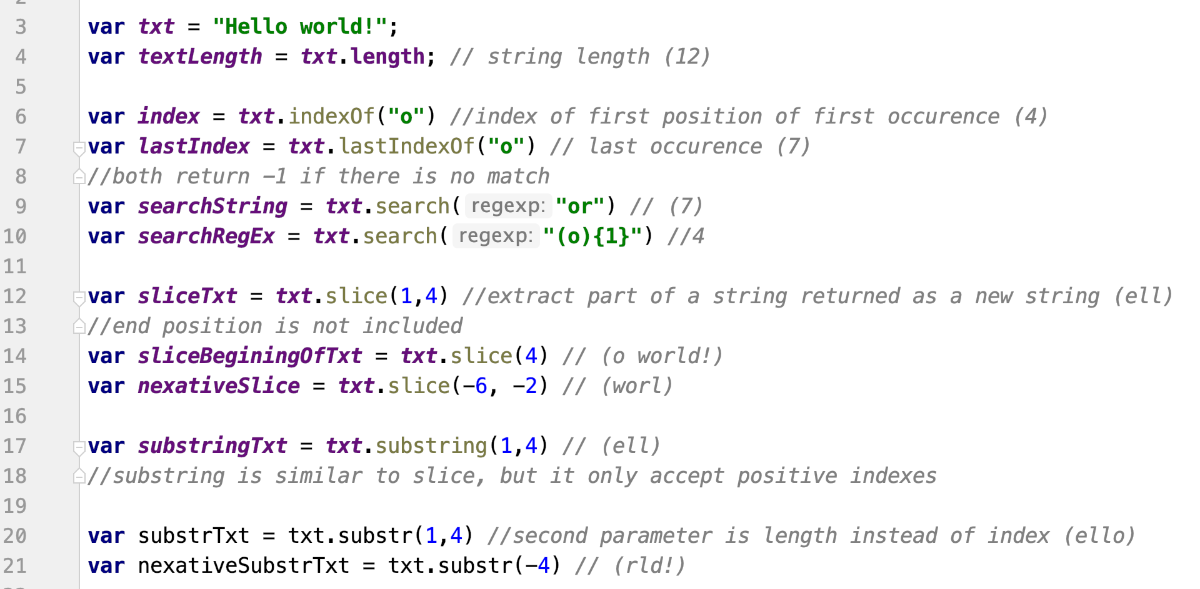
String Methods - Find and Extract

Slide 27
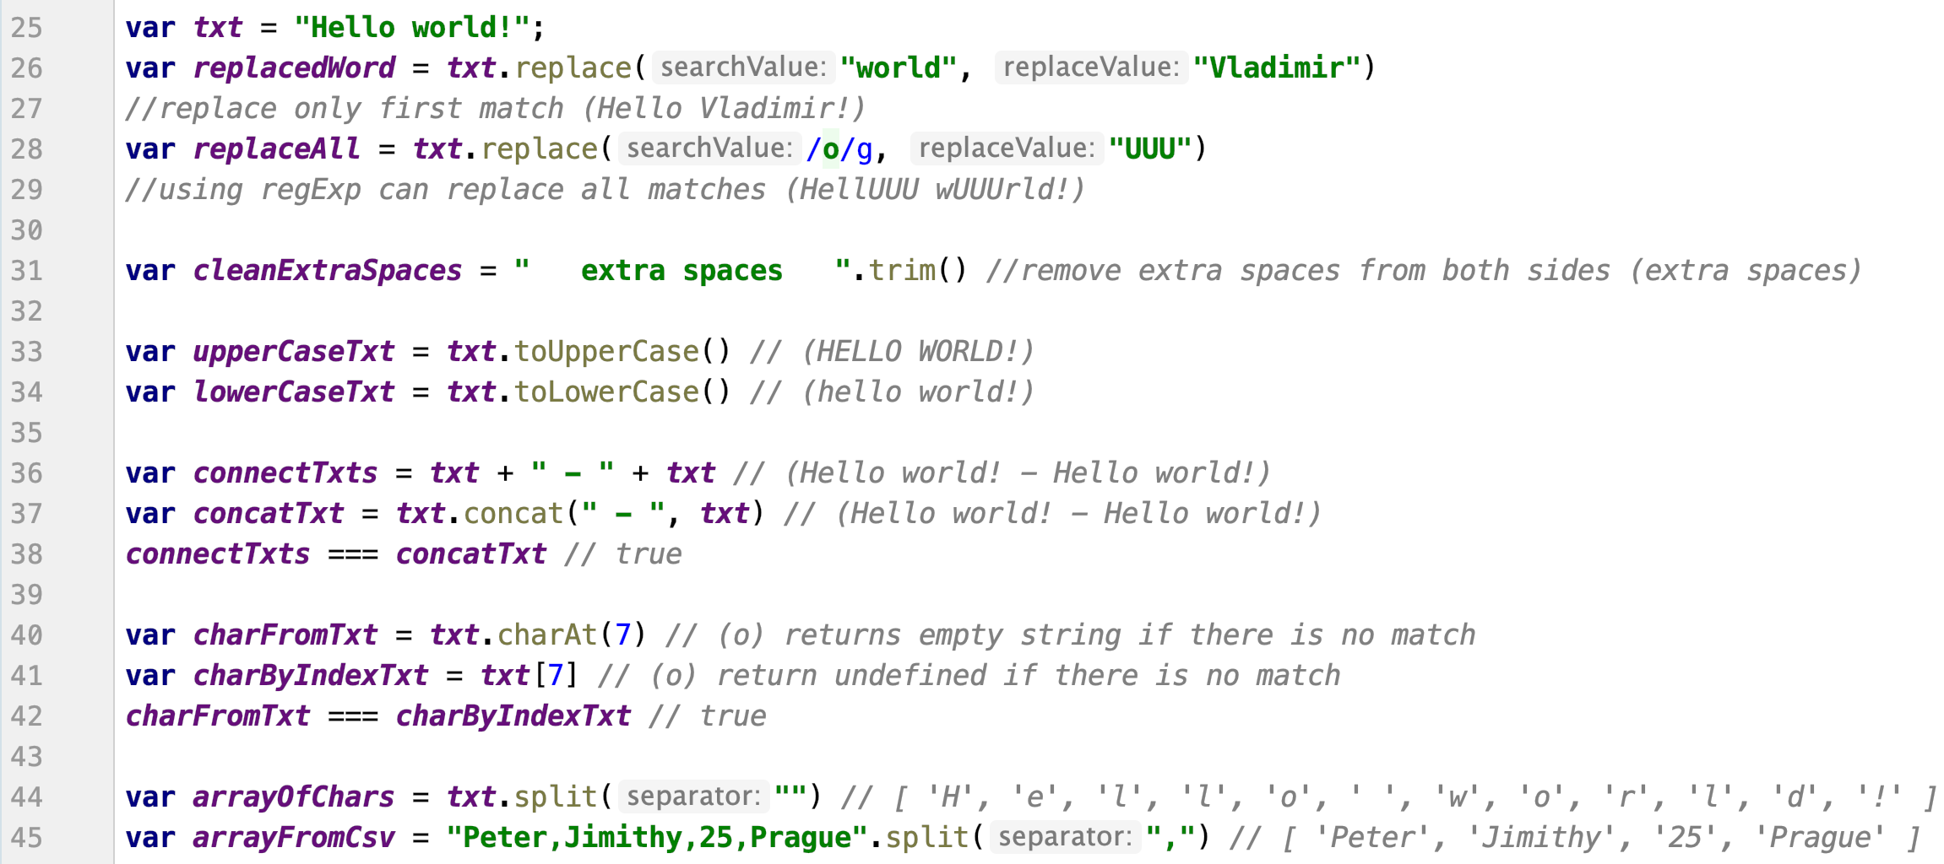
String Methods - Modify and Convert

Slide 28
Exercise 2
2.1: camelCase to snake_case
ignore multiple capital letters in a row
2.2: snake_case to camelCase
2.3: palindrom
2.4: transform CSV
2.5: count of changes "+++-+---++--+-+-++"
Notes:
- CSV is only simulated, we do not want to complicate it using multiple files

Slide 29
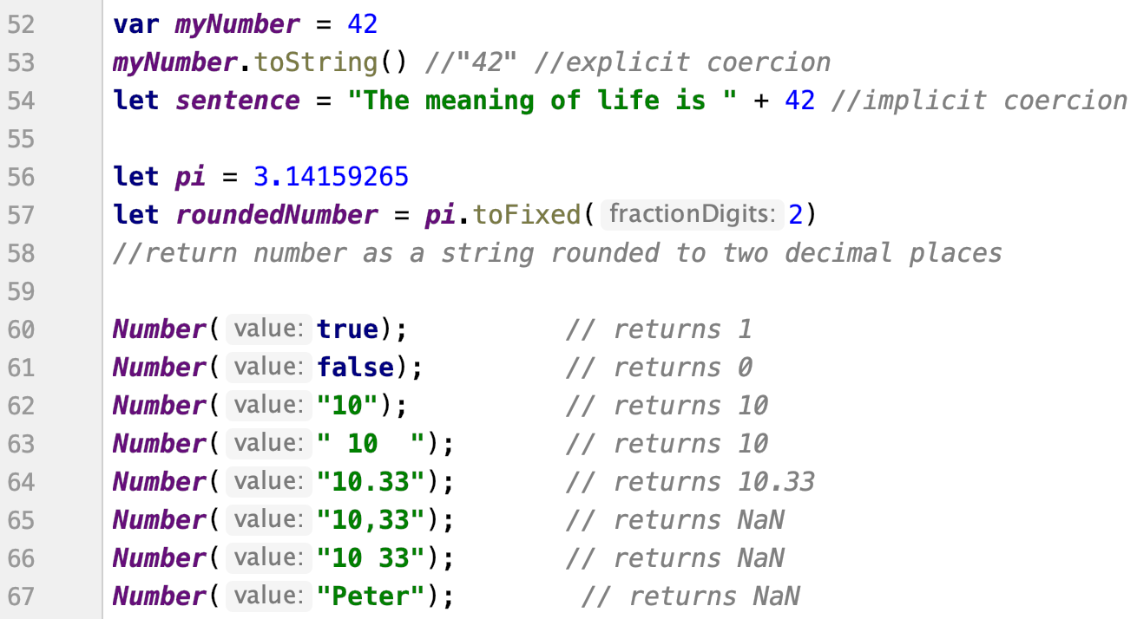
Number Methods
zaokrouhluje automaticky

Slide 30
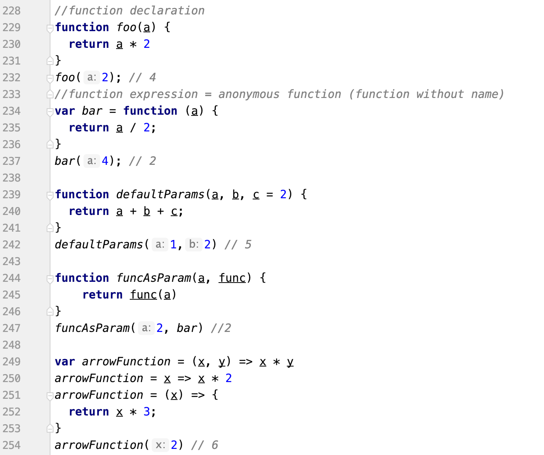
Function
function declaration or expressions
arrow function
stejný zápis, jenom v proměnné
když přijde 3 parametr, tak se defaultní hodnota přepíše
Notes:
main different between normal function and arrow function is in the way they work with THIS -> more about it in the next mission
anonymous function on line 234

Slide 31
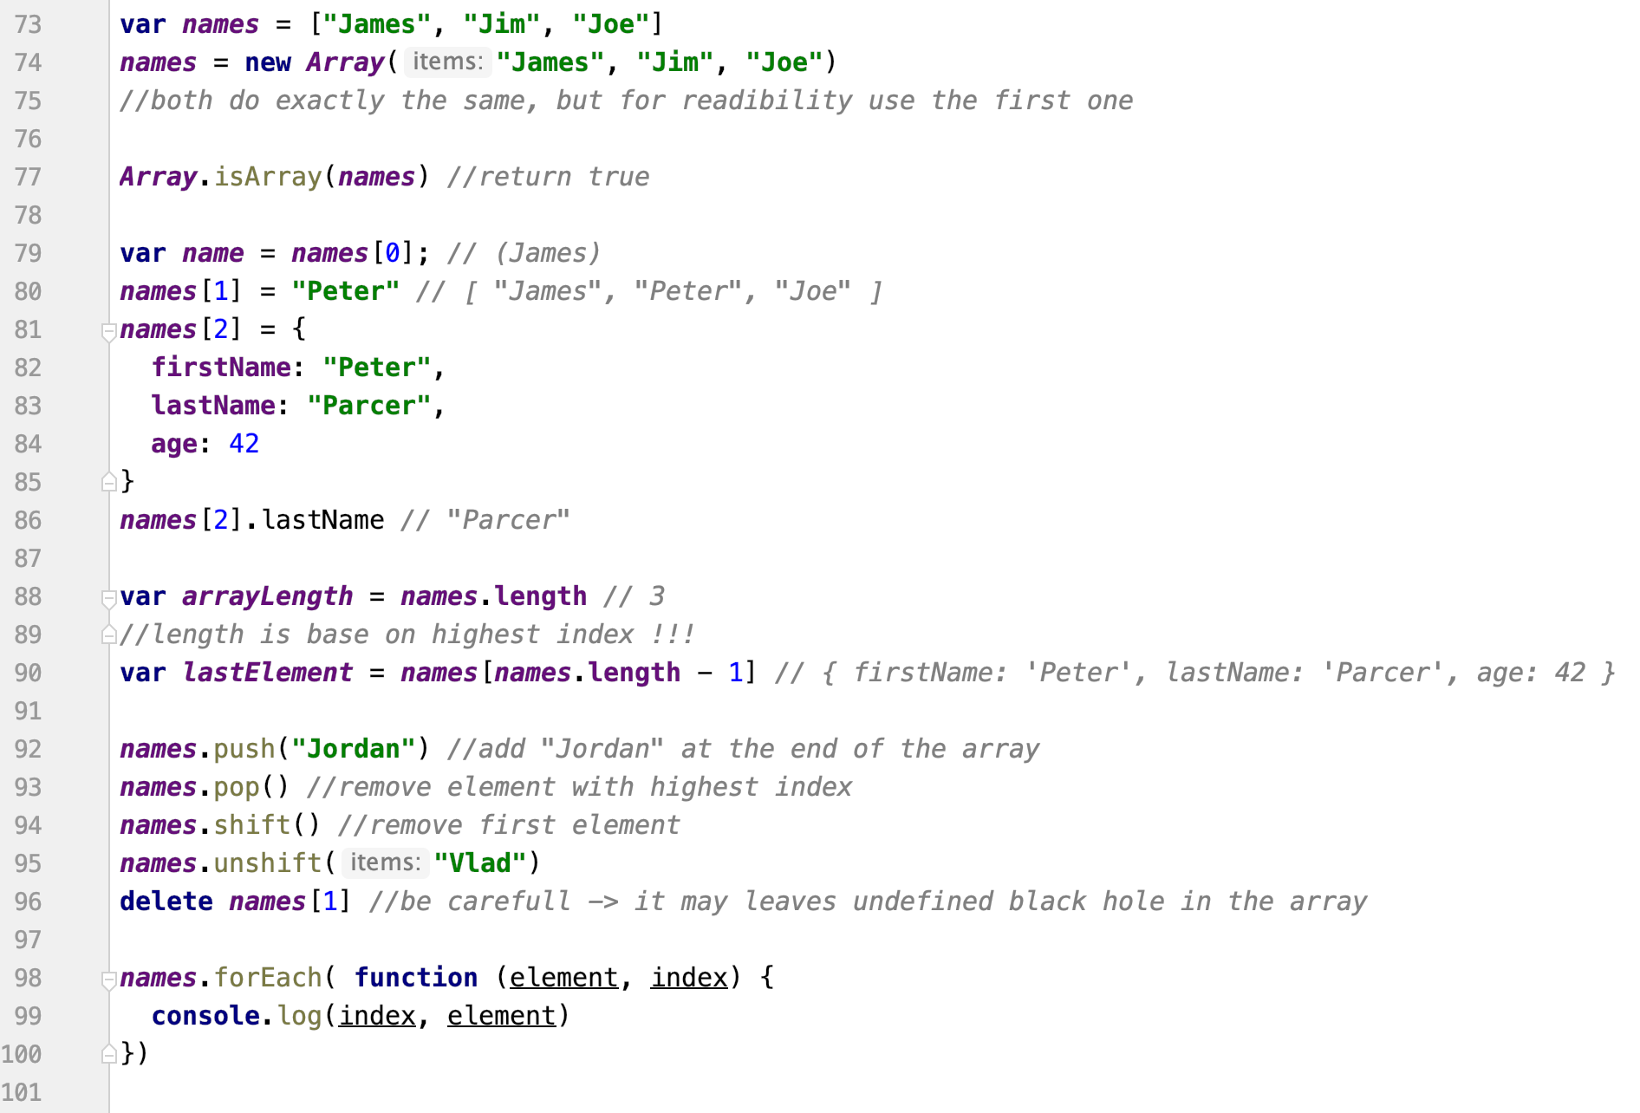
Array
vloží na první pozici
Notes:
- forEach cycle for array

Slide 32
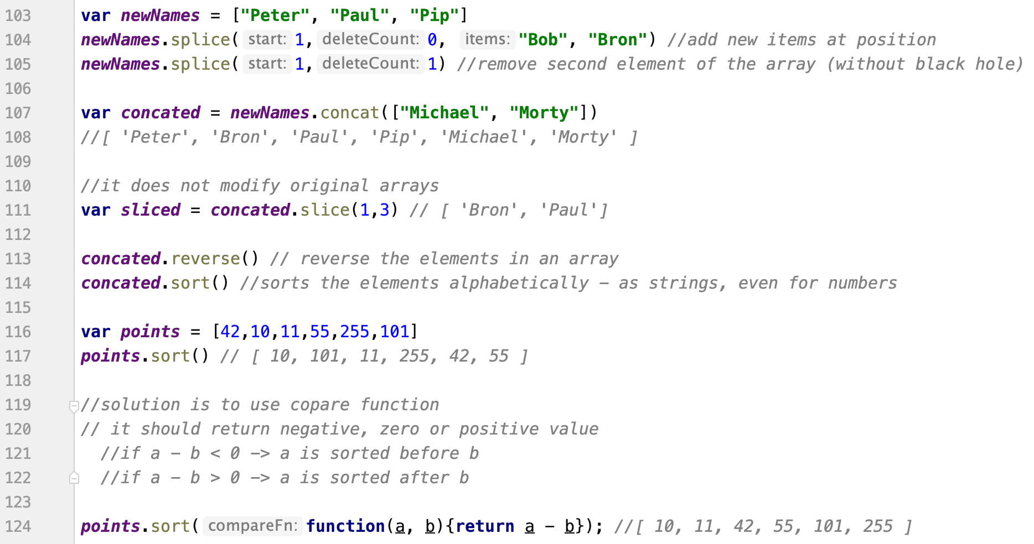
Array
vloží za petera boba a brona, v případě odstranění nebudou díry ani undefined
druhý parametr odstraní daný počet elementů za ním (z původního)
bacha, ve výchozím řadí vždy podle abecedy
pokud je kladný, prohazuje, nula a mínus nechá

Slide 33
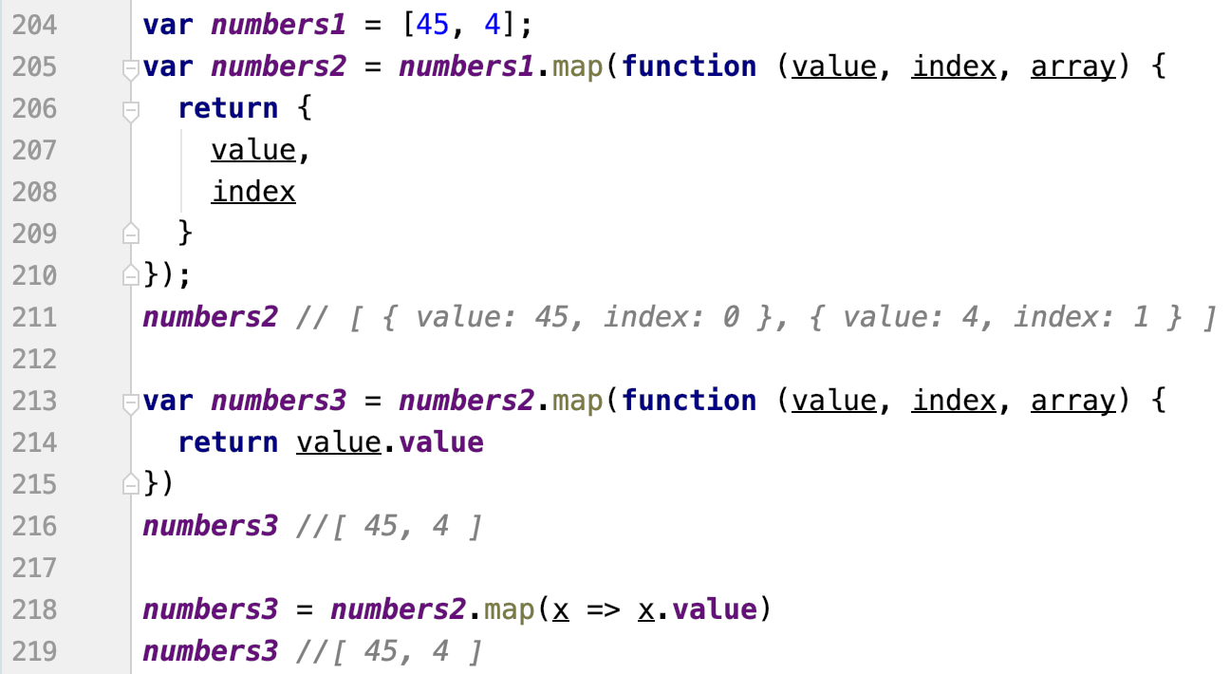
Array ES5/6 new features
Array.map
Notes:
- allows to easily mody each element of an array

Slide 34
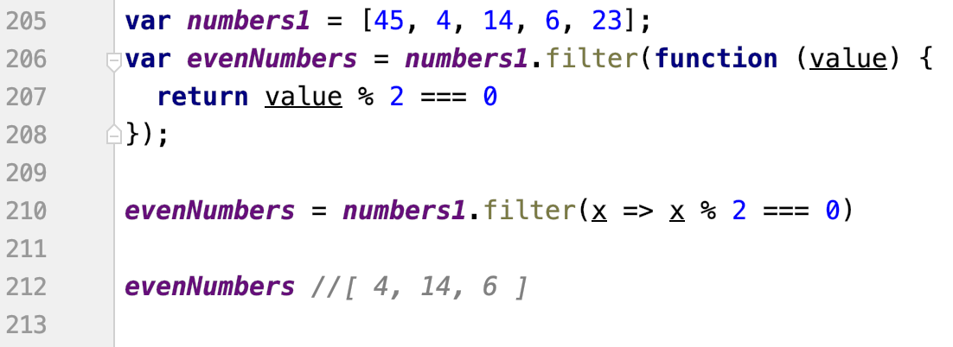
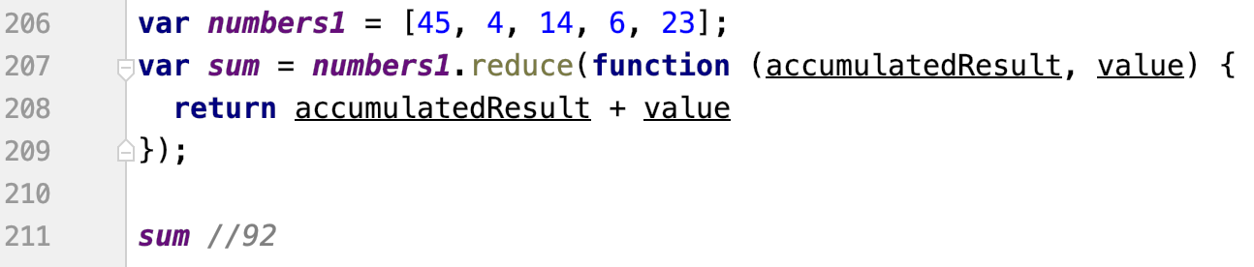
Array ES5/6 new features
Array.filter
Array.reduce
vyfiltruje odnoty na zakladě podmínky
výsledek je operace nad všema položkama
nová hodnota vychází z předcházející
tohle posčítá všechny hodnoty
reduce - protože zredukuje počet hodnot podle nějaký akumulační funkce
Notes:
- filter only values which you want and then you can reduce them to single output like total sum

Slide 35
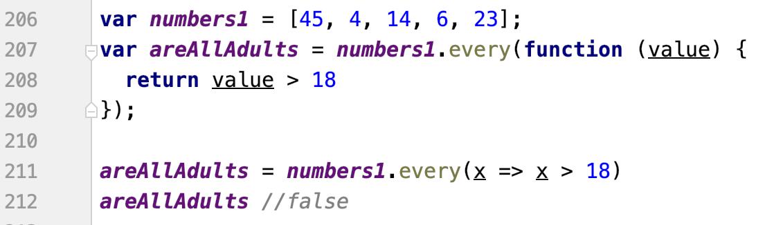
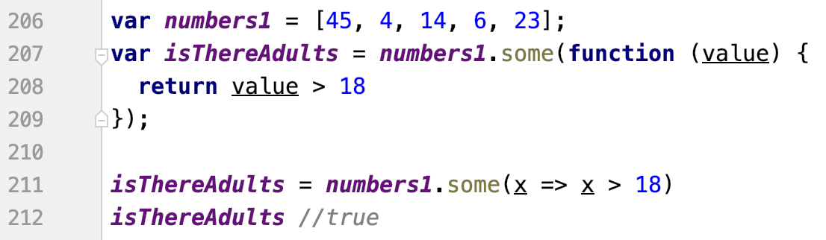
Array ES5/6 new features
Array.every
Array.some
zkontroluje, že všechny hodnoty splňují danou podmínku
zjistí, alespoň jednu. Pokud alespoň jedna, přeruší a vrátí
Notes:
- check that every element match the rule or at least some of them do

Slide 36
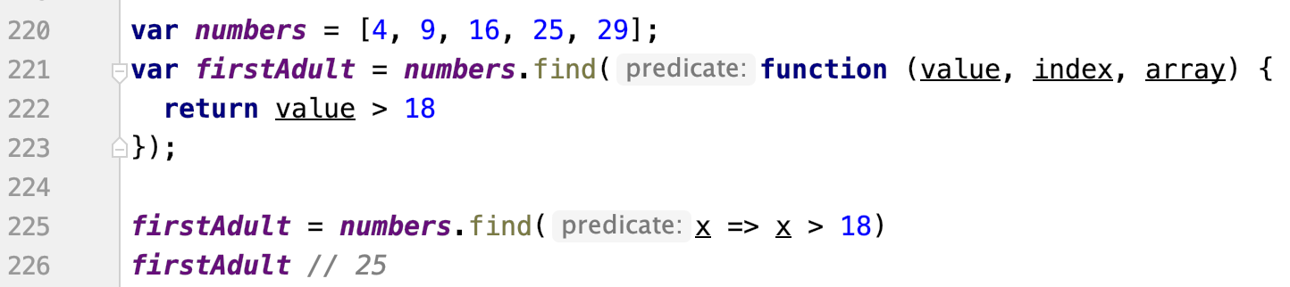
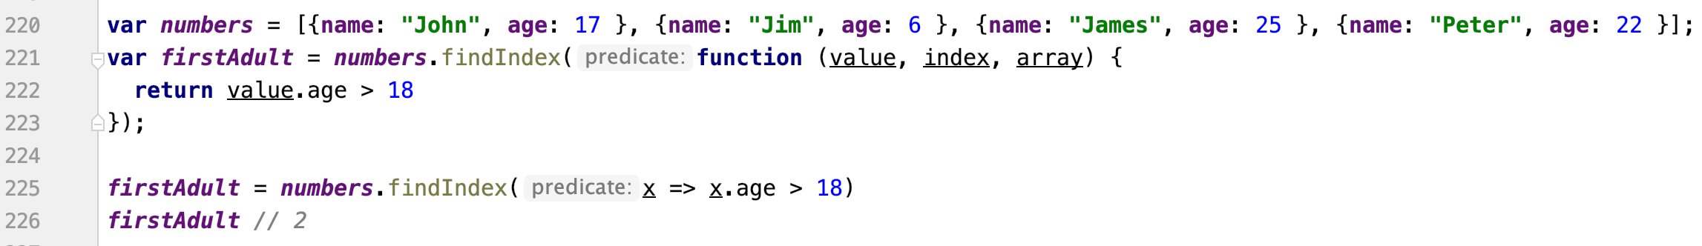
Array ES5/6 new features
Array.find
Array.findIndex
najdi prvni hodnotu, která má...
vrátí hodnotu na daném indexu, která plní podmínku, pouze první
Notes:
- find and get exact element or at least it index

Slide 37
Exercise 3
3.1: sort array descending using compare func
3.2: create function foo that accepts 3 functions and 1 number as params
each of these functions accept 1 param - number and return another number
default value for that number is 42
function foo return largest result from one of these functions
3.3: find oldest person in array of objects using array.reduce
3.4: add luckyNumber to each person in array using array.map
luckyNumber is equal to total length of their full name (with space)
3.5: function returning Nth smallest element

Slide 38
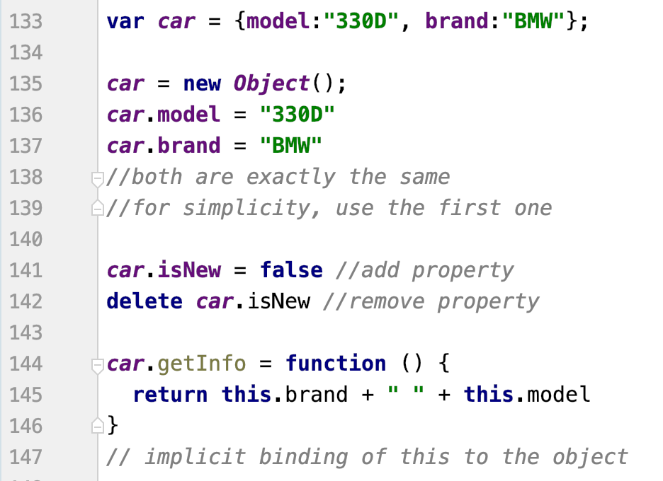
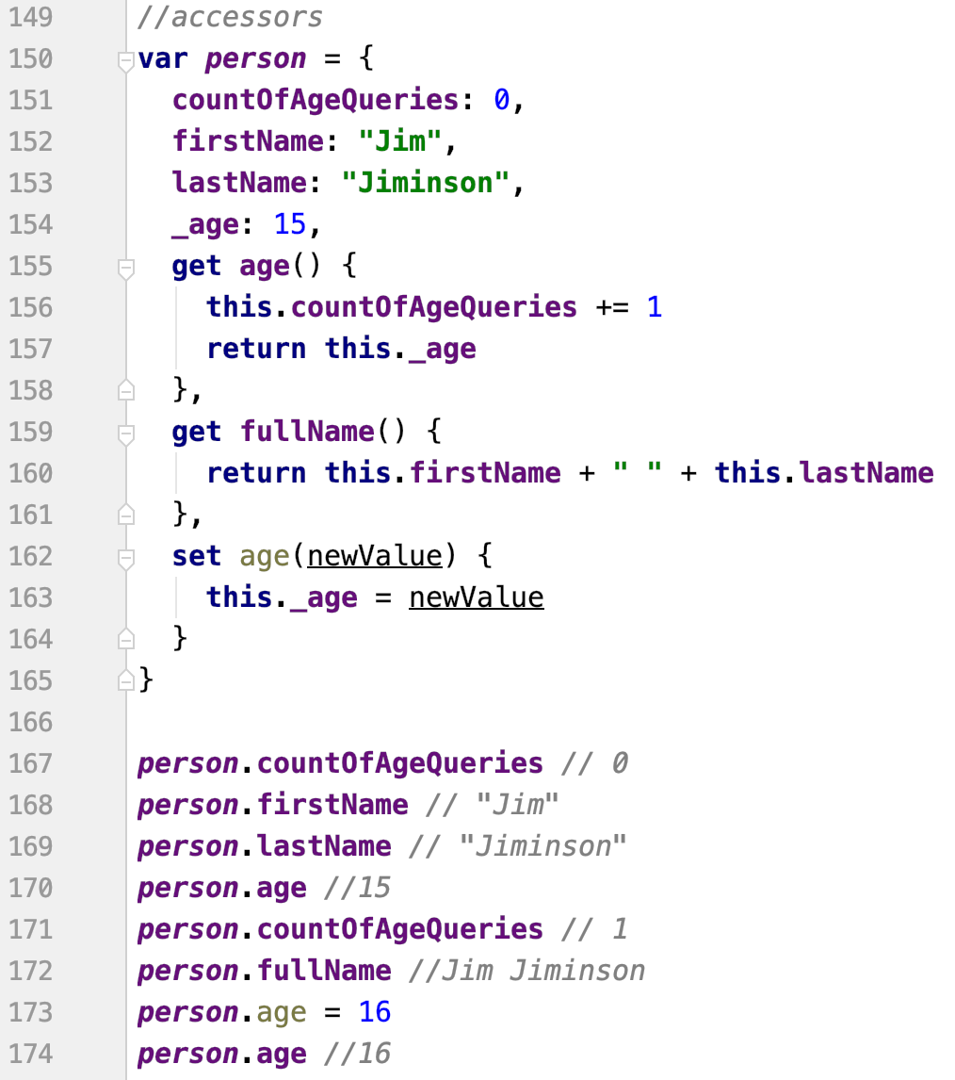
Object
in JS almost everything is an object
primitive values are immutable - objects are mutable
Notes:
immutable = always create new one and destroy the old one
mutable = modify existing one

Slide 39
Exercise 4
4.1: get count of values with data type number (top level only)
4.2: add setter which also store previous values on the object
4.3: remove all private properties (starts with _) from the object
Notes:
- this exercise is optional, there might not be enough time for it if a students are not so good

Slide 40
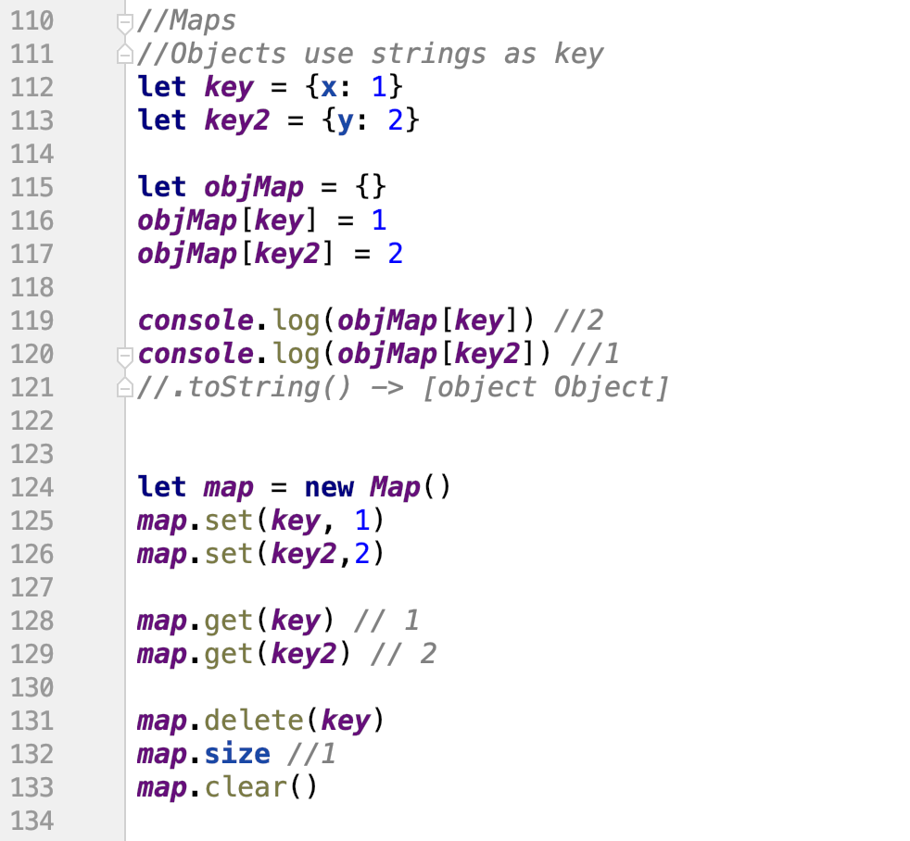
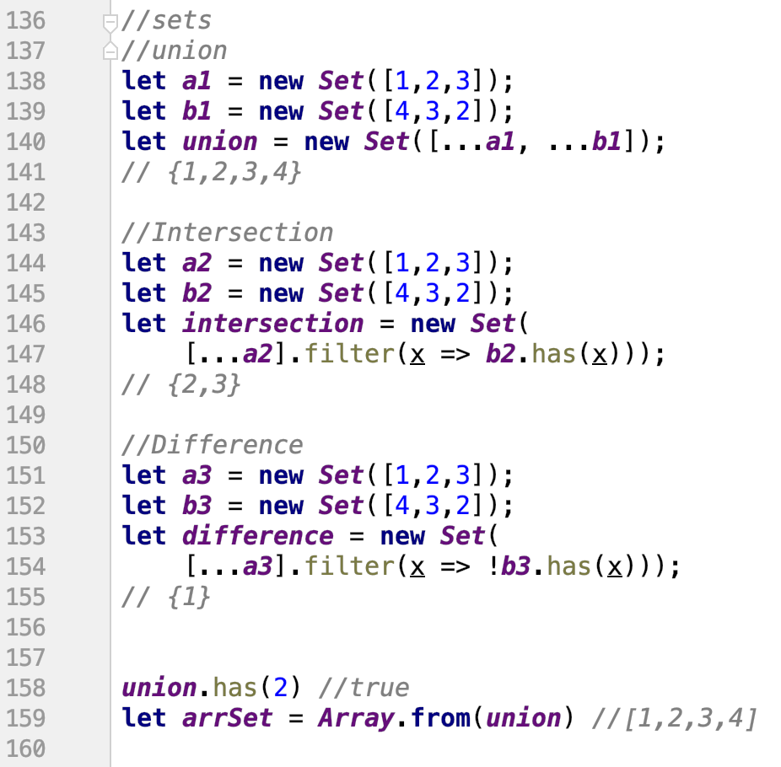
Map and Set
ES6 feature
mapa s unikátními hodnotami
Notes:
- Map can have any data type as a key, that’s why it should be prefered in many cases instead of object which allows only string and everything else is converted to it

Slide 41
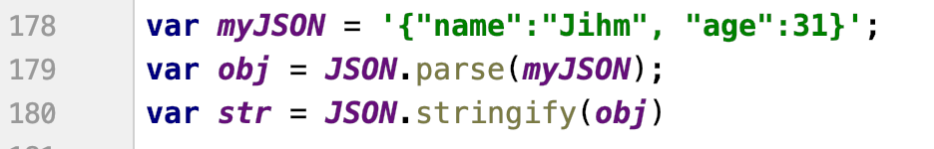
JSON
je to to samý co objekty v JS
JavaScript Object Notation
syntax for storing and exchanging data
it is text, written witch JS object notation
JSON is text, any JS object can be converted into JSON
JS has built-in functions for converting allowed data types:
string
number
object
array
boolean
null
Notes:
in JS you want always use JSON, because it easy to use and has full support, on the other hand, XML is something we want to prevent if it possible

Slide 42
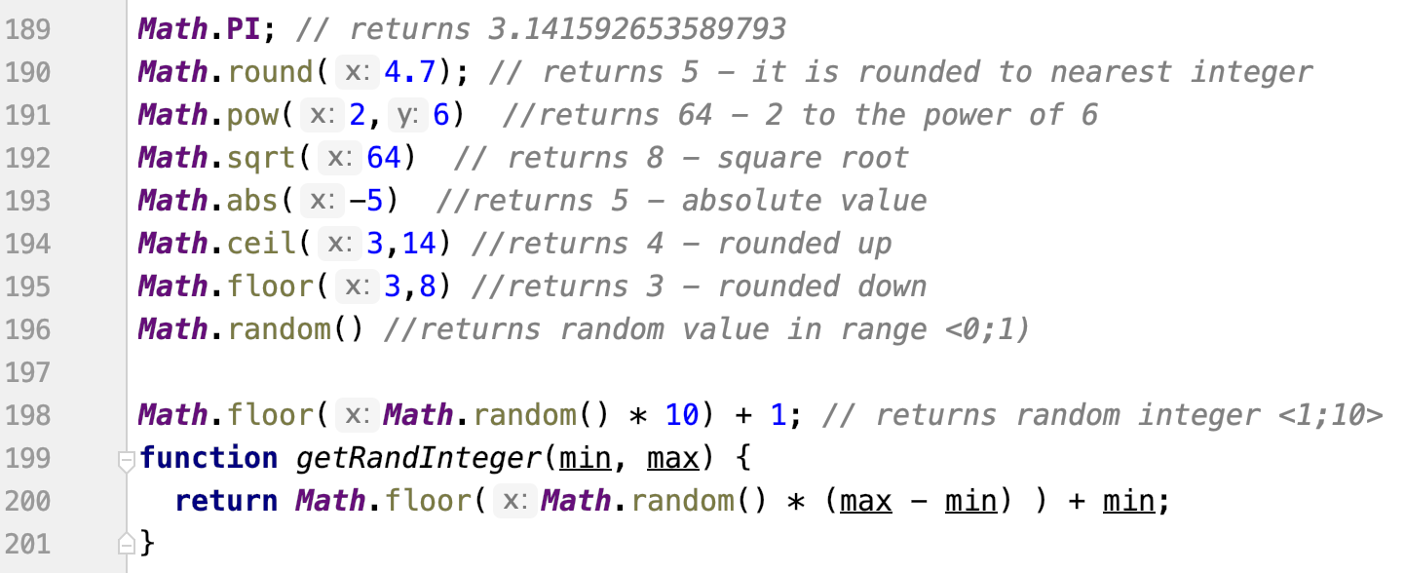
Math

Slide 43
Notes:
good job ☺

